Slide 1
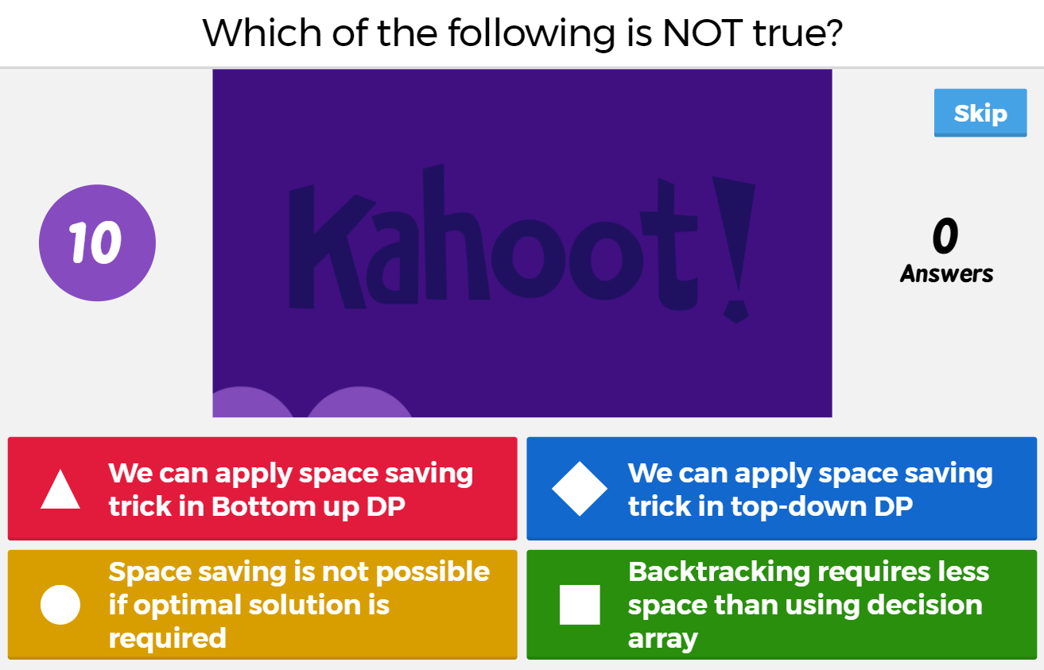


Slide 2
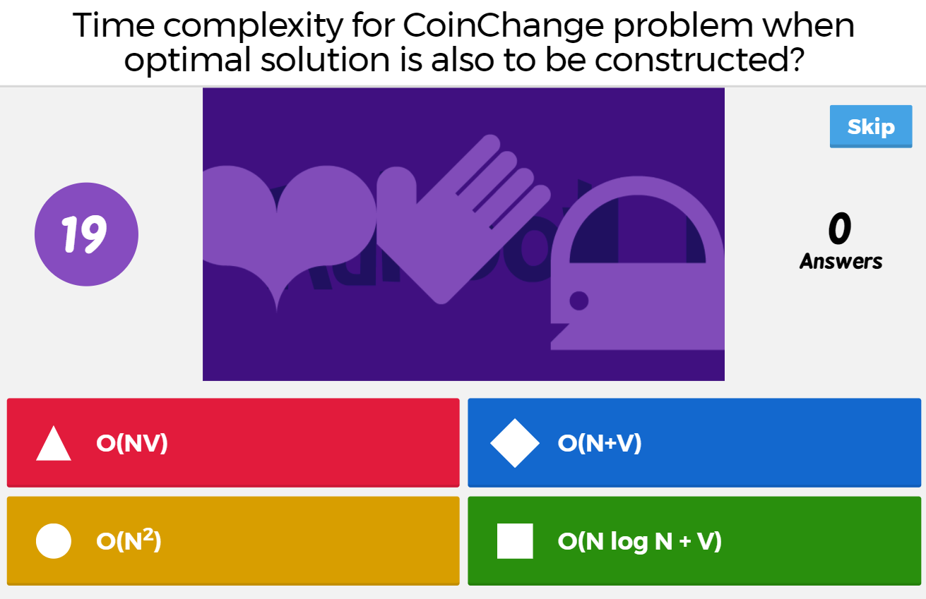

Slide 3
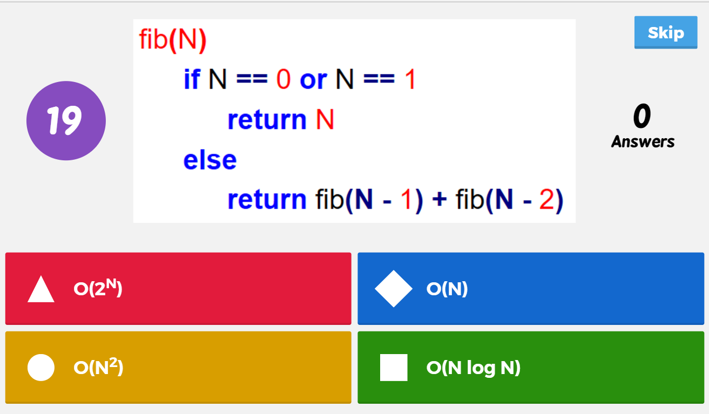
What is the space-complexity of this algorithm?
Although time complexity is O(2^N), the space complexity is O(N) because the maximum recursion depth is O(N). In other words, maximum number of frames in recursion stack at any time is O(N).

Slide 4
